Slide 1

CHENNAI HOUSE PRICE PREDICTION
MASTER DATA SCIENCE
NESAN K
Curious? Try this out.
Chennai House Price Predictor – ML App

Slide 2
Chennai House Price Prediction:
Problem Statement
Real estate transactions are quite opaque sometimes and it may be difficult for a newbie to know the fair price of any given home. Thus, multiple real estate websites have the functionality to predict the prices of houses given different features regarding it.
Such forecasting models will help buyers to identify a fair price for the home and also give insights to sellers as to how to build homes that fetch them more money.
Chennai house sale price data is shared here and the participants are expected to build a sale price prediction model that will aid the customers to find a fair price for their homes and also help the sellers understand what factors are fetching more money for the houses?
train-chennai-sale.csv - Google Drive

Slide 3
Approach towards to the problem:
Part I: Data Science perspective:
Data Collection
Understanding the data
Data Cleaning
Exploratory Data Analysis (EDA) – Bivariate Analysis
Feature Engineering & Feature Selection
Building ML models
Analyzing the importance's of features
Part II: Model Deployment:
Part III: Business perspective:
Interpretation of results
Solutions for scaling the business

Slide 4
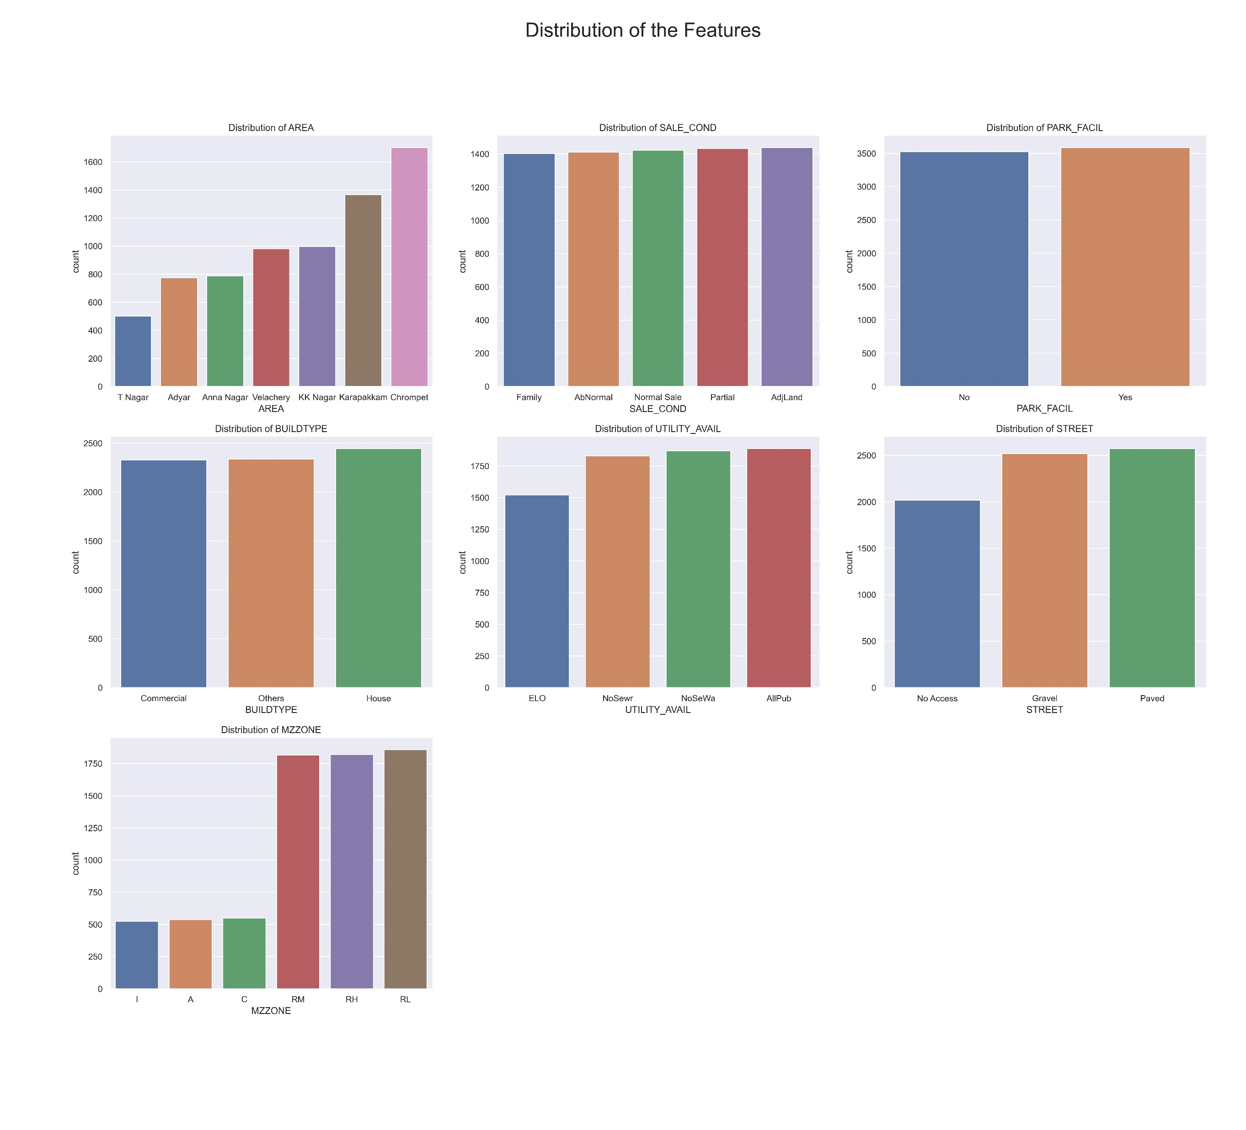
PART I - DS

Slide 5
DISTRIBUTION of FEATURES:
AREA:
- People preferred to buy in Chrompet, the most followed by Karapakkam. In T Nagar, they showed less interest.
SALE_COND:
- There is no better pattern in this feature, with little changes among them. People don't show variations in buying based on type of sales.
- From the data, Adjacent Land sold a lot, Family properties transferred less.
PARK_FACIL:
- Here too, there is not much difference though people opted for the houses with Parking Facility.
- From this, we could infer that half of the population don't own vehicles or the parking facility doesn't mean a lot to them.
BUILDTYPE:
- People are more interested in Houses than Commercial buildings and others.
UTILITY_AVAIL:
- AllPub: All public Utilities (Electricity, Gas, Water & Sewerage) - preferred a lot
- NoSewr: Electricity, Gas, and Water (No Septic Tank)
- NoSeWa: Electricity and Gas Only (No Water and Septic Tank)
- ELO: Electricity only STREET - Least preference
STREET:
- There is a demand for accessibility to their houses / others. So, they opted for paved road and if not available, they preferred at least Gravel laid.
MZZONE:
- People showed more interest in Residential Low Density(RL) following Residential High (RH) and Residential Low (RL) Density areas than Commercial (C) and Agricultural (A) zones. They bought buildings the least in Industrial (I) zones.

Slide 6
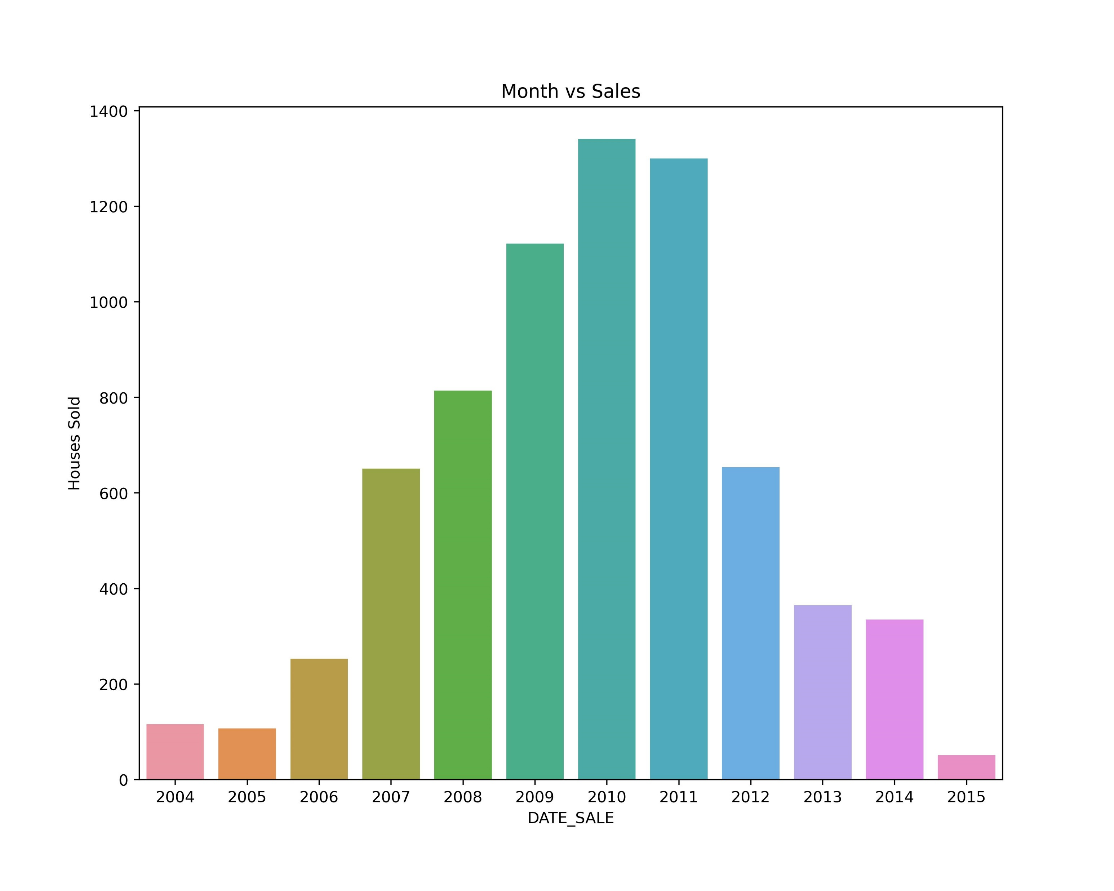

Slide 7
DISTRIBUTION of FEATURES:
INT_SQFT - The range lies between 500 sqft and 2500 sqft.
DIST_MAINROAD - Uniformly distributed with skewness of 0.02.
N_BEDROOM - Skewed (Truncated) distribution with skew of 1.16 with the mode being 1. Ranges between 1 and 4.
N_BATHROOM - Skewed (Truncated) distribution with skew of 1.34 with the mode being 1 Ranges between 1 and 2.
N_ROOM - Normal distribution with skew of 0.1 with the mode being 4 Rooms. Ranges between 1 and 6.
AGE_OF_BUILD - Skewed distribution with 0.27 skew. People preferred 19-20 years of buildings with highest priorities.
*plots are not shown here

Slide 8
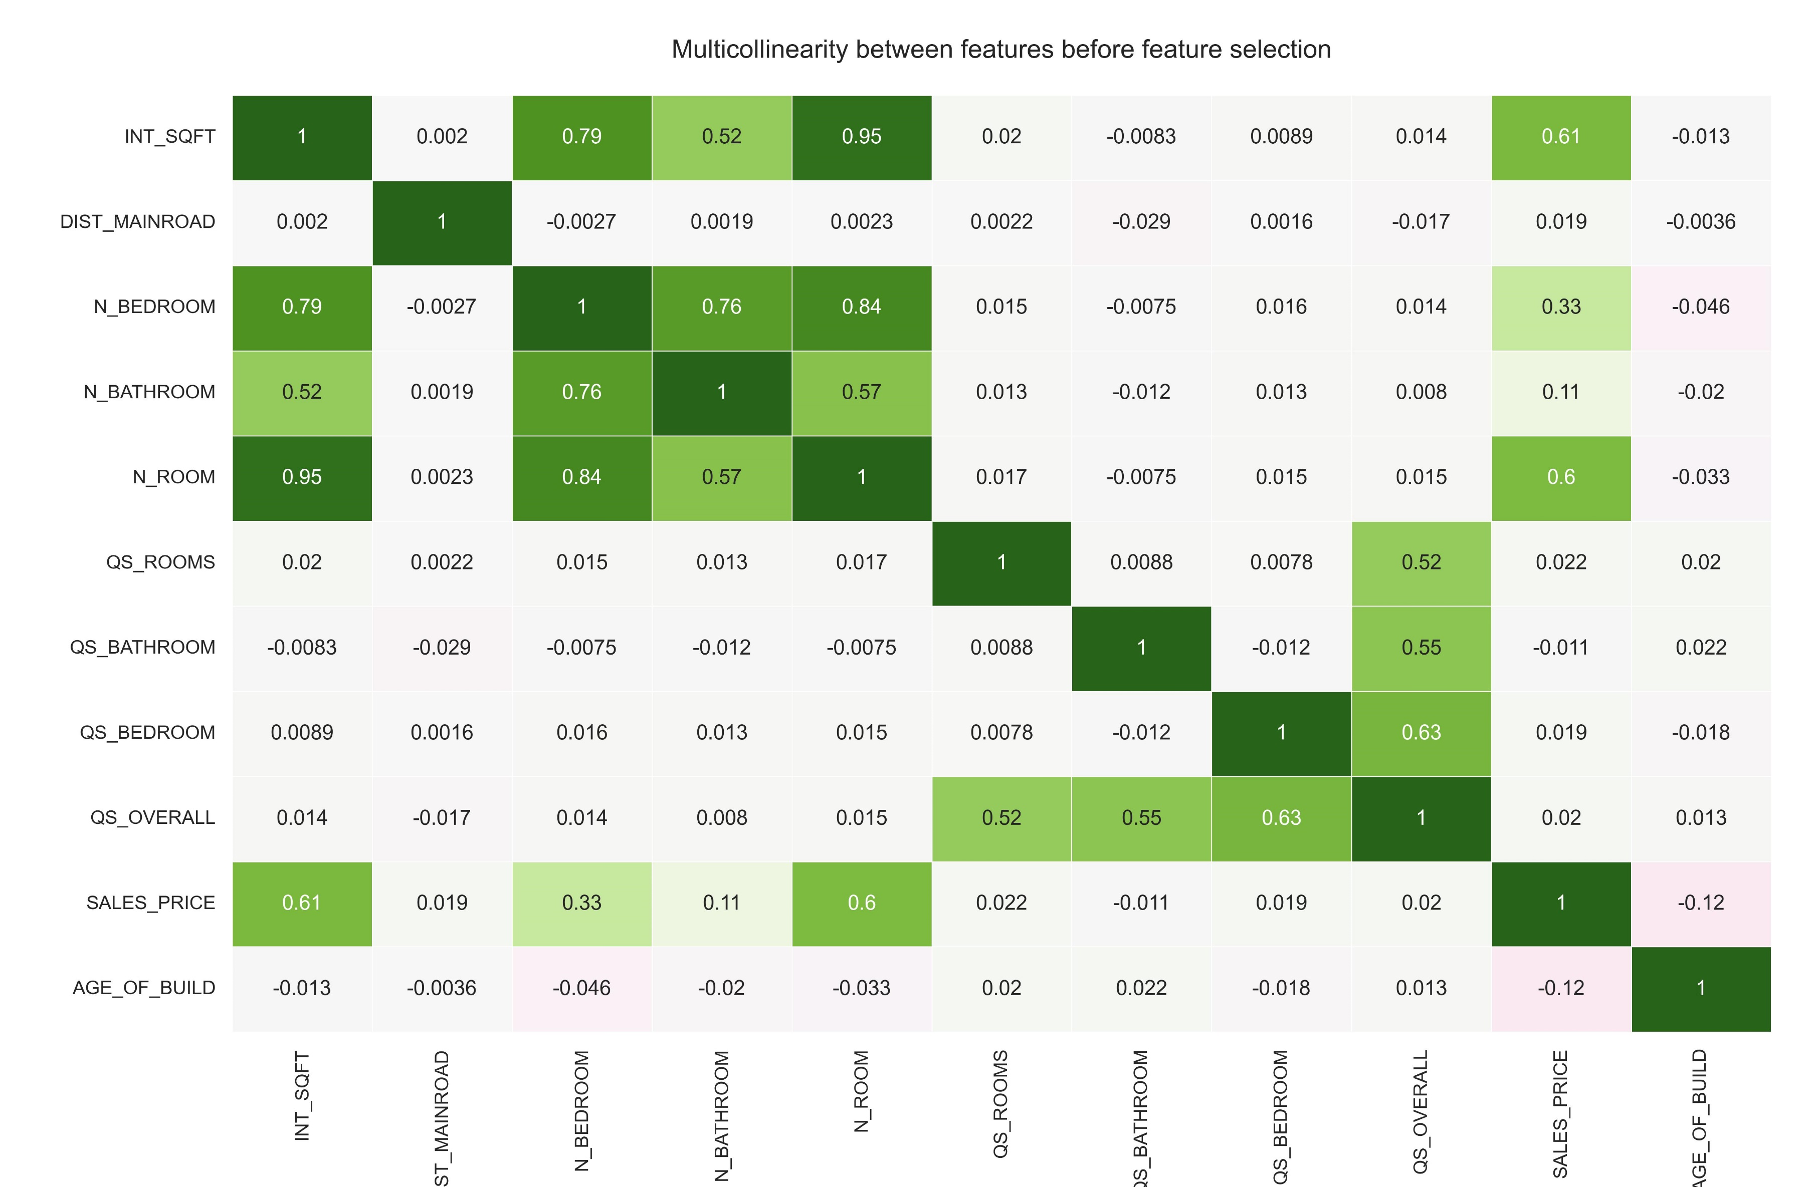

Slide 9
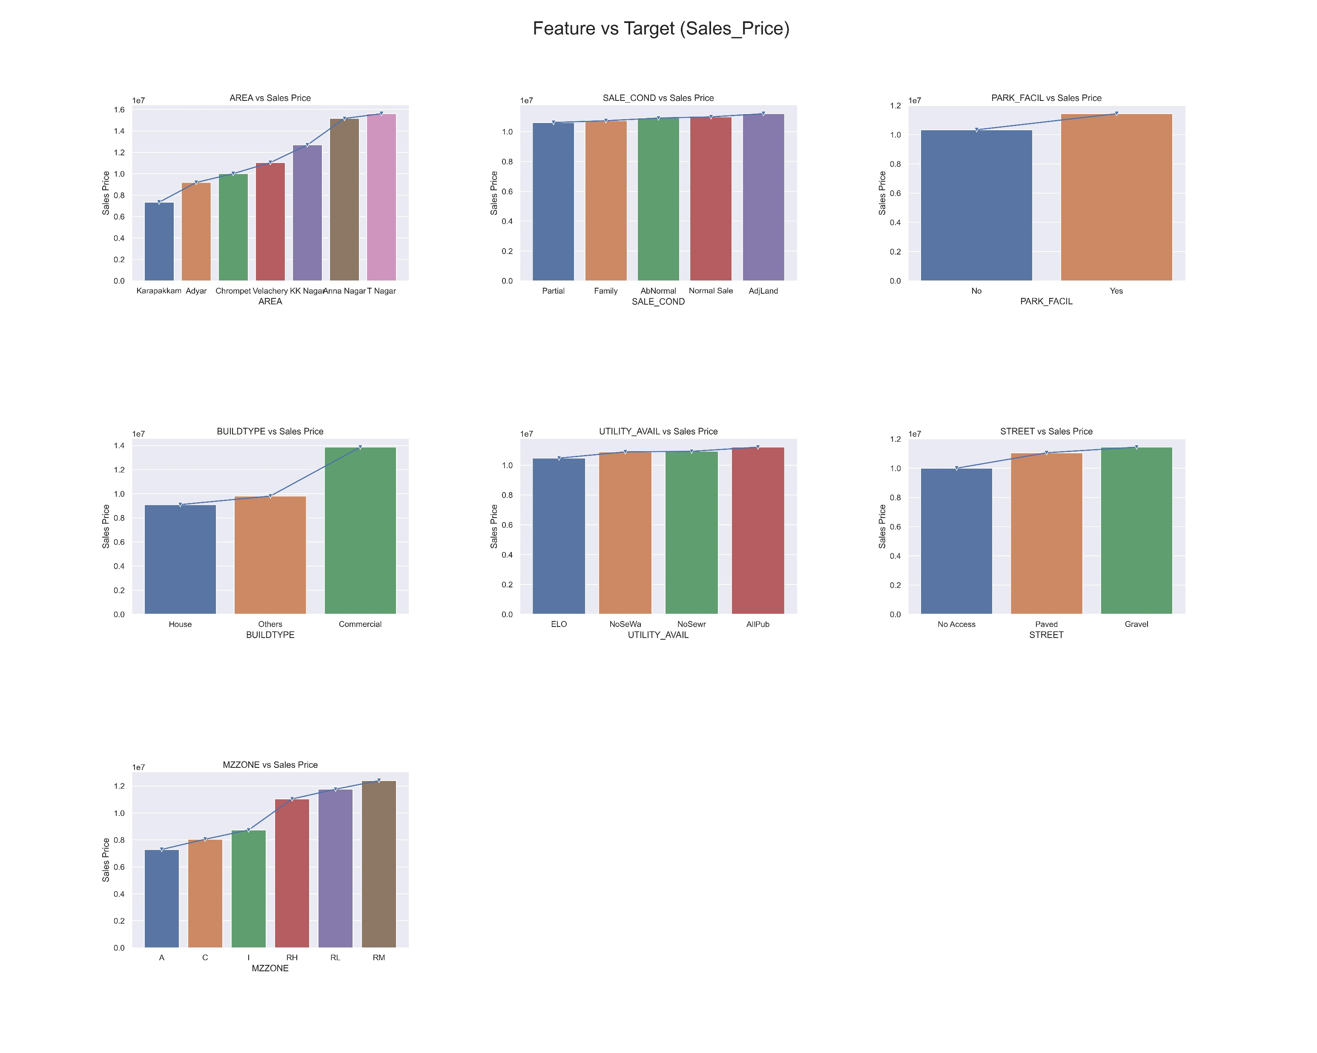

Slide 10
Feature vs Target – EDA (Bivariate Analysis)
Features selected: Linear relationship is estabished (i.e.) -0.02 > Correlation ,r | Correlation,r > 0.02
1. INT_SQFT
2. N_BEDROOM
3. N_ROOM
Features that need transformation to be used: Relationship is there but not in linear fashion.
1. N_BATHROOM
2. AGE_OF_BUILD
Features to be deleted: No relationship could be established with Sale Price.
1. DIST_MAINROAD
2. QS_BEDROOM
3. QS_BATHROOM
4. QS_ROOMS
5. QS_OVERALL

Slide 11
ML Models:
1. Linear Regression: R2 Score: 0.91
2. KNN Regressor: R2 Score: 0.95
3. Decision Tree: R2 Score: 0.97
4. Random Forest: R2 Score: 0.99
5. XG Boost: R2 Score: 1.0 (best)
Based on R2 Score, XG Boost model performs well and considering its feature importance for Business Solutions. The top features which influences the model are in order as follows:
- AREA
- INT_SQFT
- MZZONE
Clubbing Build Types: BUILDTYPE_Commercial + BUILDTYPE_House + BUILDTYPE_Others

Slide 12
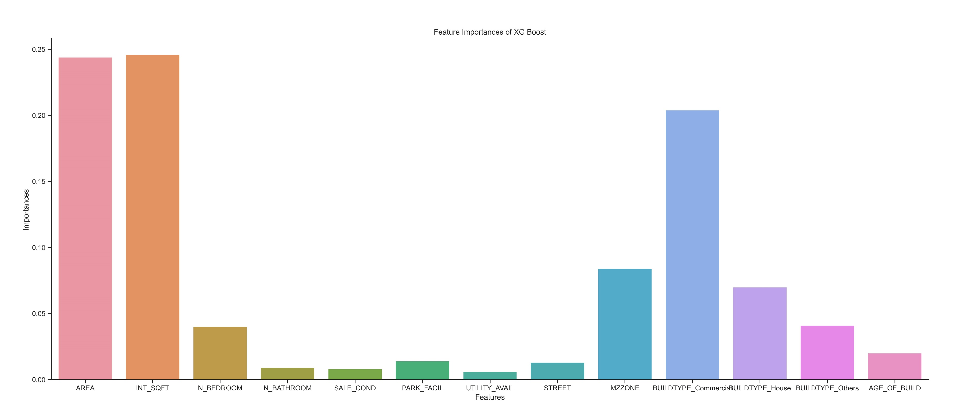
Feature Importance's:

Slide 13

ML model is deployed in Cloud using Streamlit
PART II – MODEL DEPLOYMENT
Chennai House Price Predictor – ML App

Slide 14
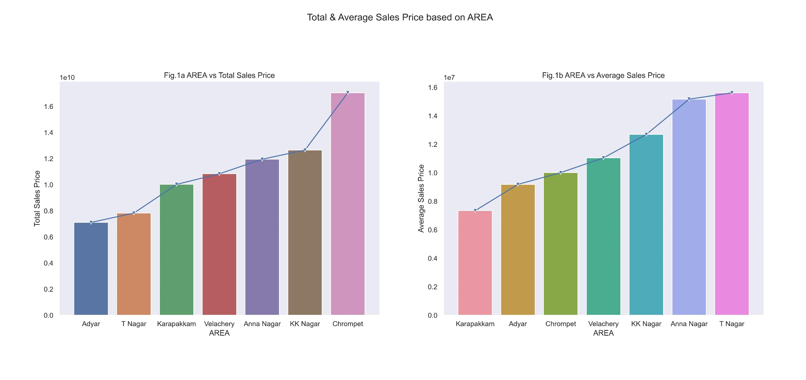
PART III – BUSINESS SOLUTIONS

Slide 15
Business Insights:
- T Nagar: Though the sales of buildings is less in magnitude, the average sales price is higher than the other areas, which stood at 15.5 Million per building which greater than twice the average in Karapakkam.
- People tend to buy more buildings and houses in Chrompet. Total sales price in Chrompet exceeds the next area KK Nagar by at least 500 Crore Rupees. Though the average sales price is around 10 Million Rupees. There is a huge demand (market potential) in Chrompet. So, we have huge customer base here, we can operate for long time and can work on multiple designs.
- Anna Nagar: Count 800, average sales price: 15 Million, total sales 11 Billion. So, focusing on Anna Nagar fetches more revenue per building, which increases the profit.
- KK Nagar: Count 1000, total sales price: 12.5 Billion, average sales price: 12.5 Million.
1. Based on the profitability, T Nagar, Anna Nagar, KK Nagar fetches more.
2. Based on the market sustainability/demand, Chrompet have higher market potential.
Focusing on both these aspects, employing two different models like one for high-yielding & another for long-yielding, the business can be taken to new heights.

Slide 16
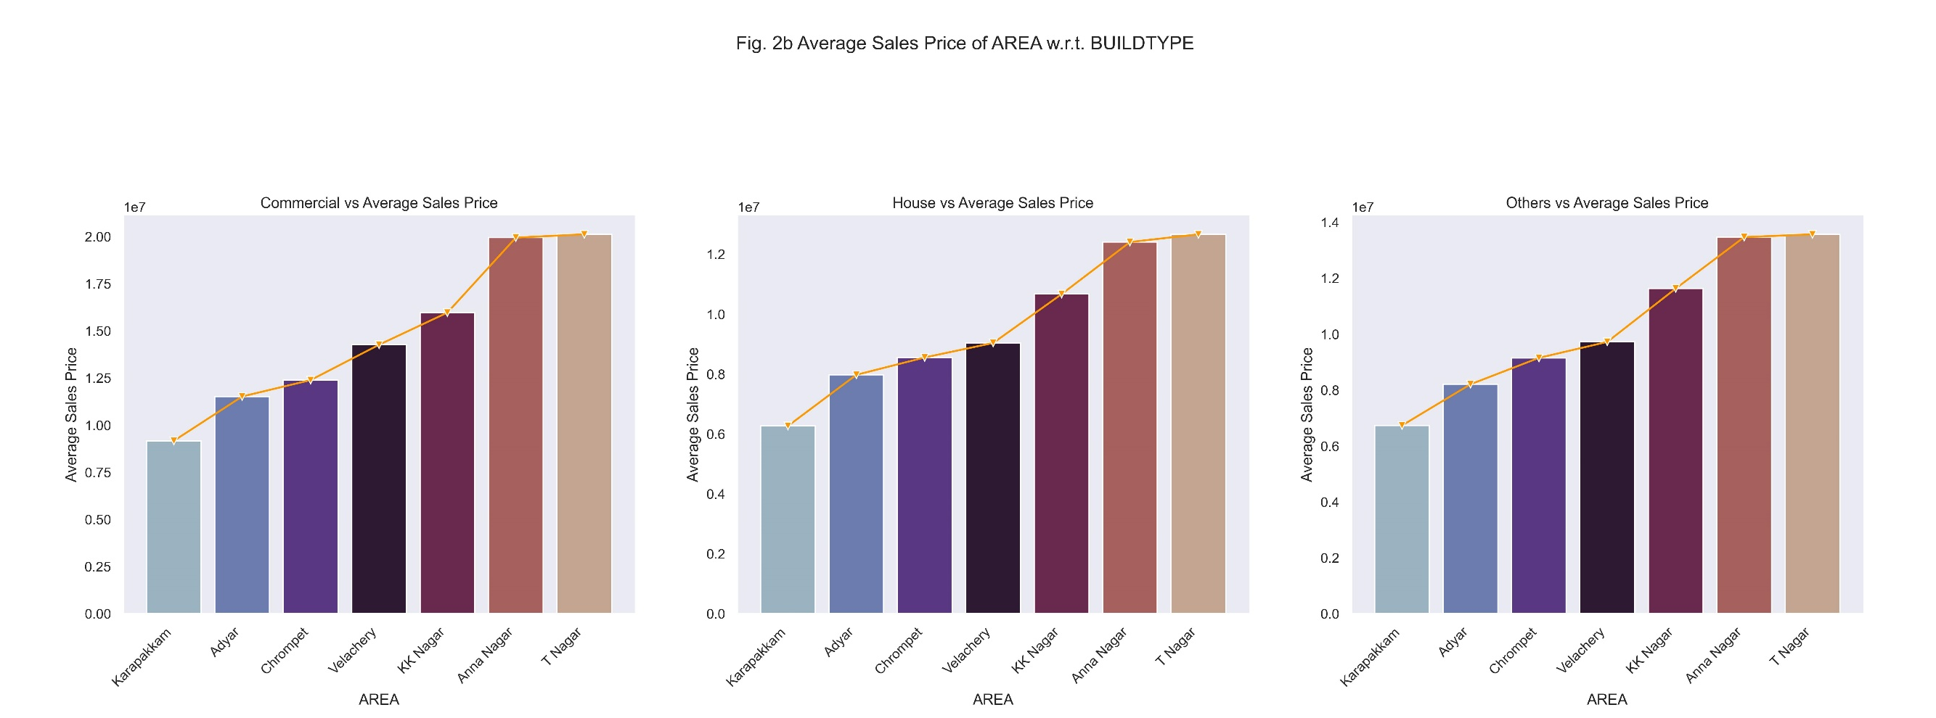
Business Insights:
- Commercial Buildings fetch more revenue and profitability.
- Average Sales Price: Commercial > Others > House.
- They lies in the same order as AREA that were suggested earlier. Based on the high-yielding AREA (max. T Nagar with an average of INR 2 Crore & long-yielding AREA (max. Chrompet with total of around INR 70 Lakhs), invest more in Commercial projects comparing Other build structures and Houses.

Slide 17
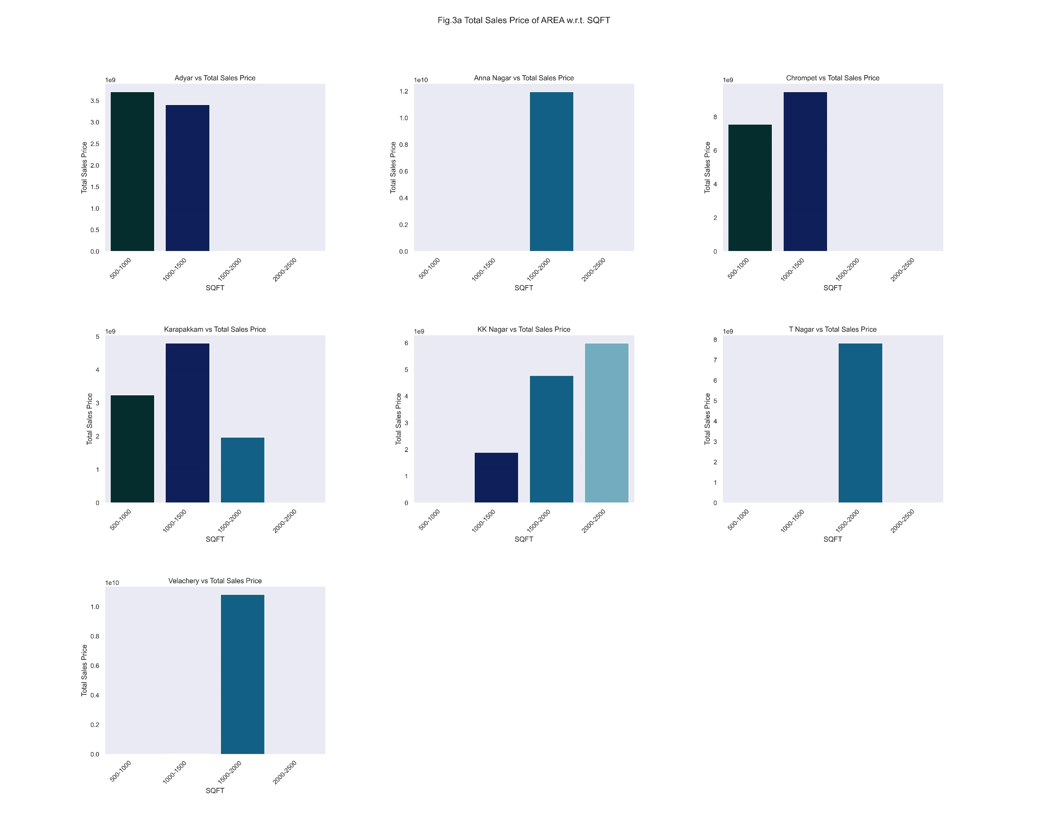
Total Sales Price in each AREA w.r.t. SQFT

Slide 18
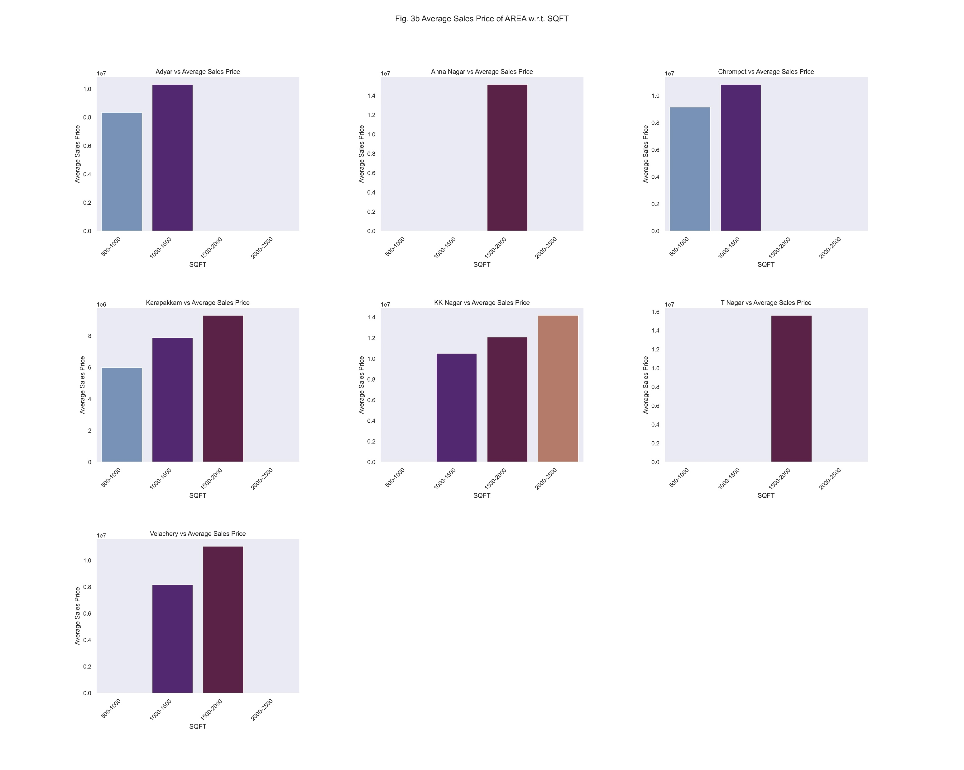
Average Sales Price in each AREA w.r.t. SQFT

Slide 19
Business Insights:
- Constructing 1500-2000 sqft buildings in T Nagar & Anna Nagar gives higher average revenue over INR 1.5 Crores comparing the same area in KK Nagar which is around INR 1.2 Crores, even, KK Nagar's 2000-2500 Sqft buildings which stood lesser at an average of 1.4 Crore Rupees ( time-consuming process with lesser returns, considering size of the building).
Top-most yielders:
1. T Nagar & Anna Nagar (1500-2000 sqft buildings) - average 1.55 Crore Rupees
2. KK Nagar (1500-2500 sqft buildings) - average 1.3 Crore Rupees
3. Chrompet & KK Nagar (1000-1500 sqft build) - average 1.05 Crore Rupees
4. Chrompet (500-1000 sqft buildings) - average 90 Lakh Rupees
On the highest yielders, constructing in Chrompet at 500-1000 sqft yields higher than the others, comparing its size, time taken to construct, the amount of revenue it fetches.

Slide 20
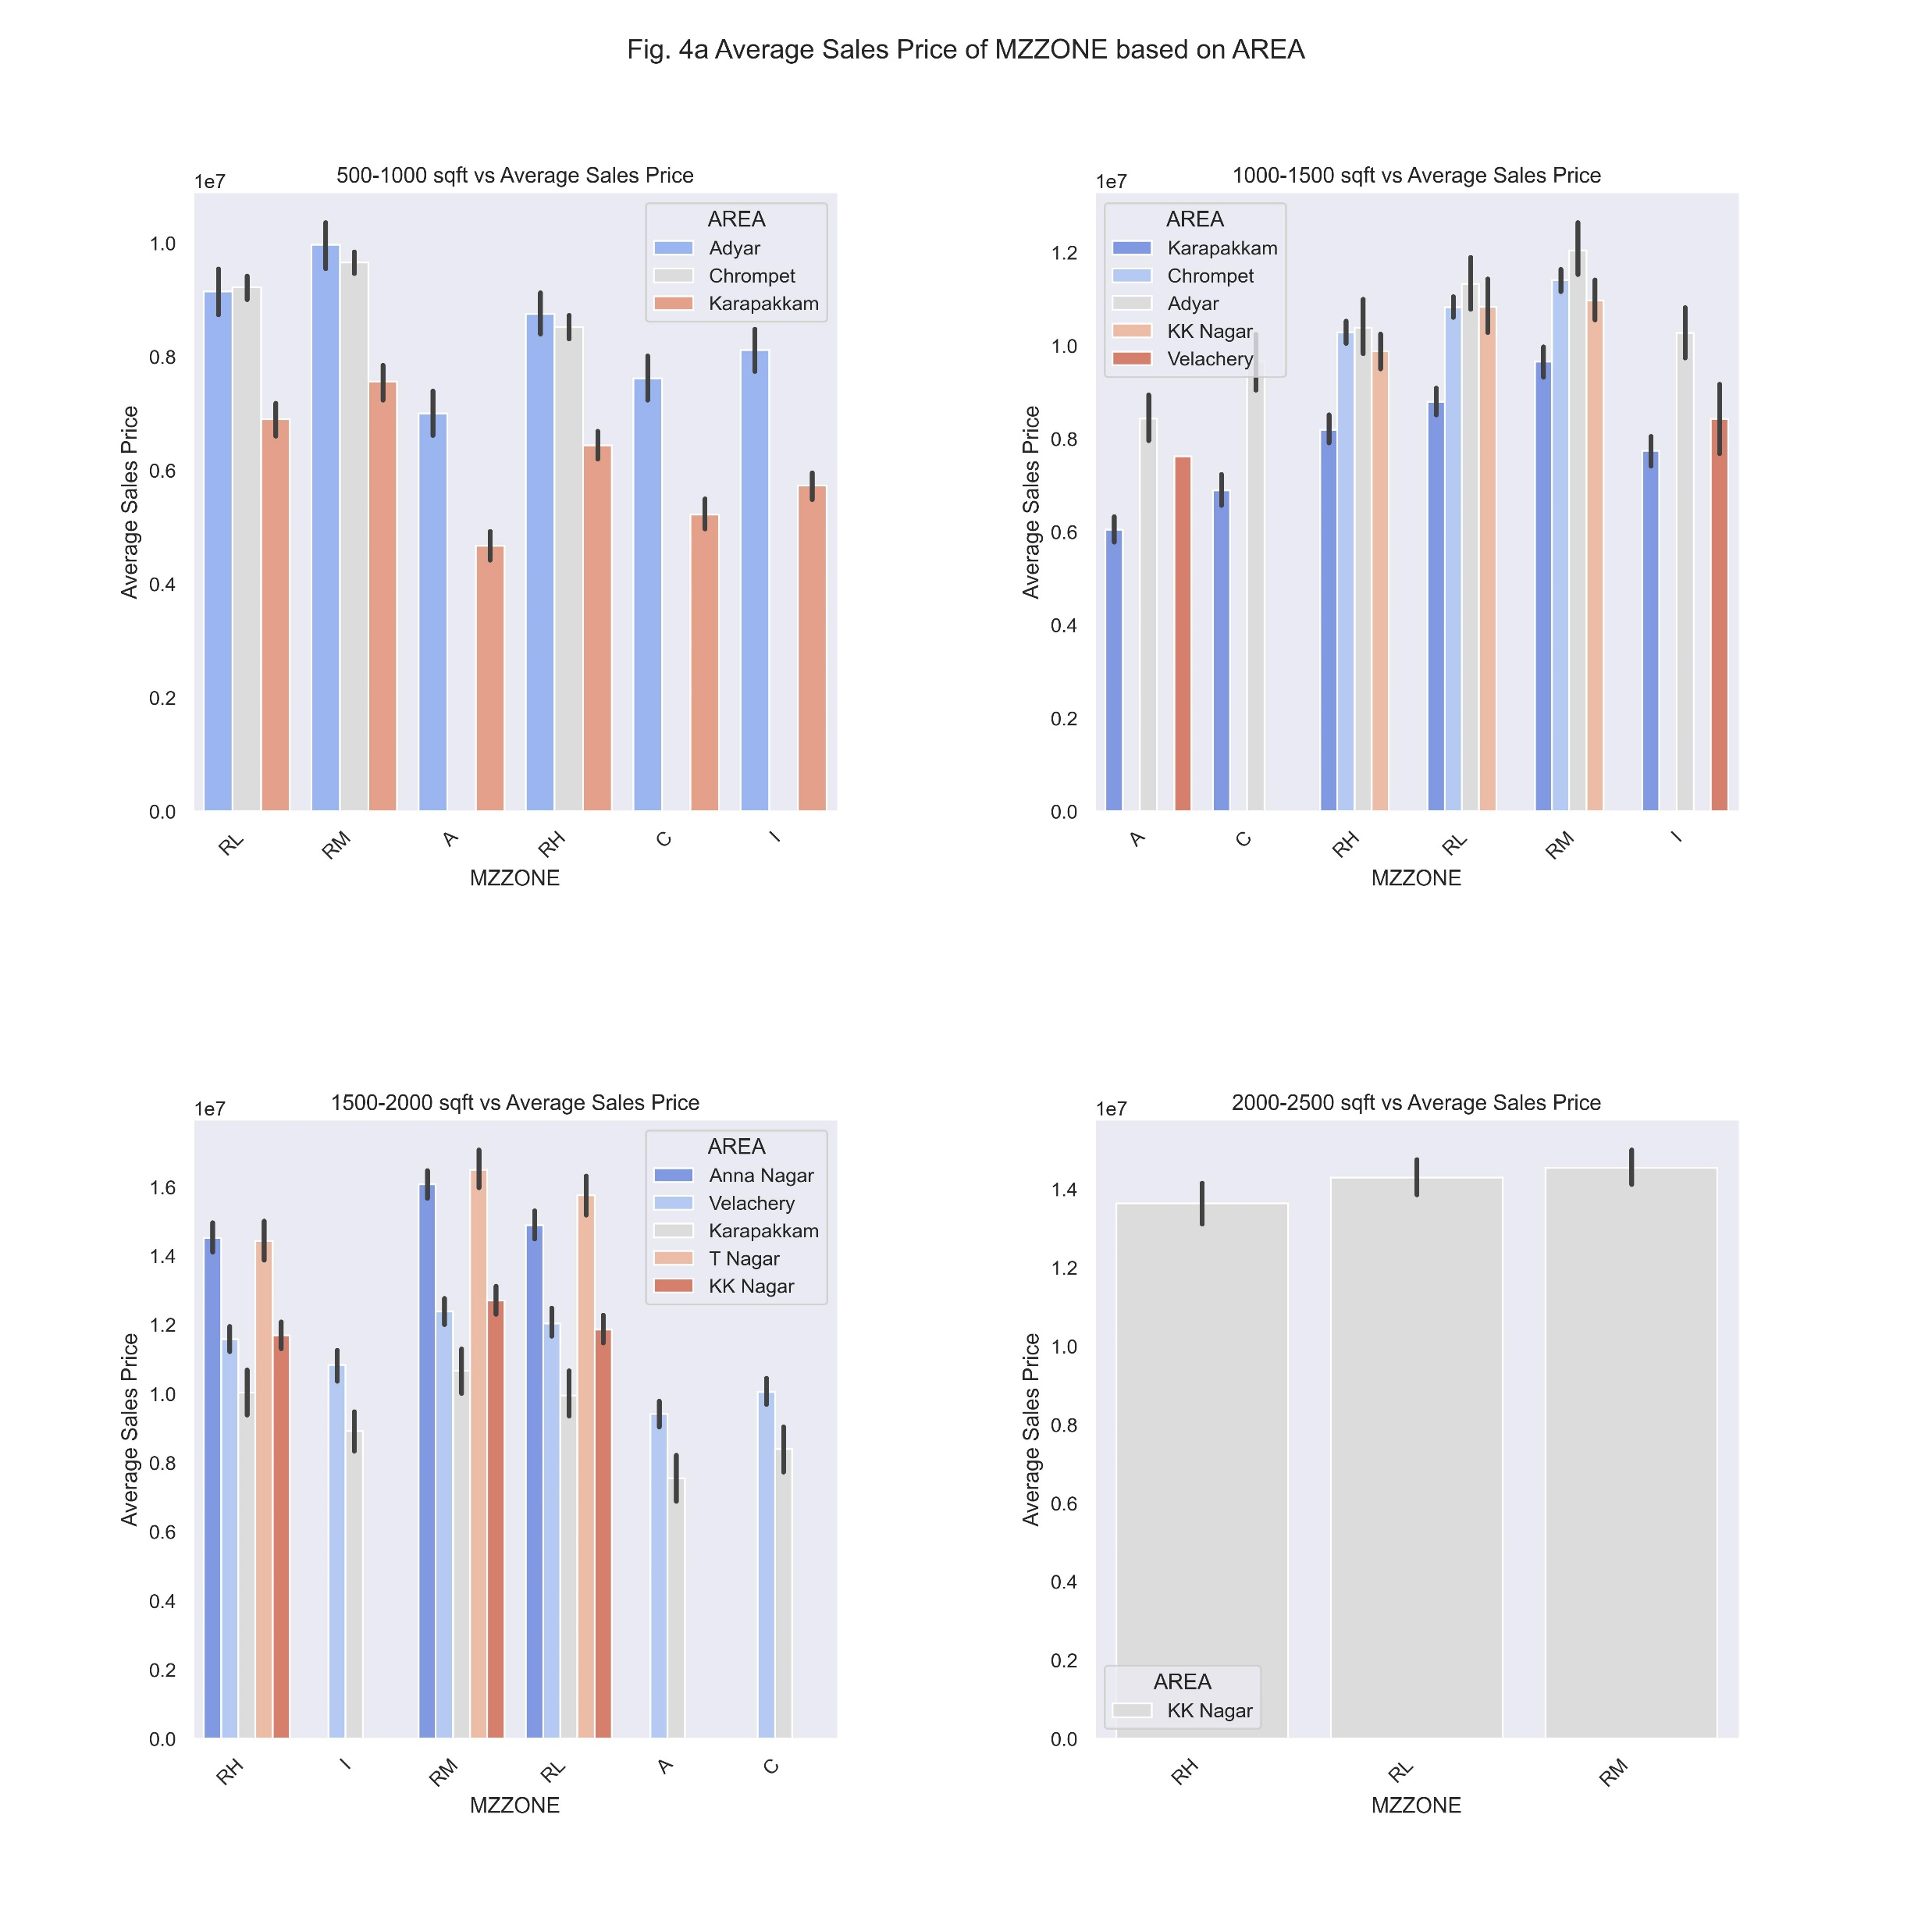

Slide 21
Business Insights:
- In 500 - 1000 sqft: Building in Residential zones fetch more revenue, especially in Adyar followed by Chrompet.
- In 1000 - 1500 sqft: For this size too, building in Residential zones fetch more revenue, especially in Adyar followed by Chrompet and KK Nagar. Especially, in Adyar, along with residential zones, industrial zone construction can also be taken.
- In 1500 - 2500 sqft: Focus more in T Nagar and Anna Nagar, in Residential zones. Constructing in Residential Medium zone yields more than 20 Lakh Rupees than in Residential High Density zone.
- In >2000 sqft: Only in KK Nagar, people buys over 2000 sqft area that too only residential plots. The average sales price is higher in T Nagar & Anna Nagar (1500-2000 sqft range) comparing this area. So, focus more there.

Slide 22
THANK YOU!!!
Feeling Insightful? Then, Choose one, A/B!
Resume
A
B

